Slide 1
Stacks and Queues
Unit 5
CPRG304 – Object-Oriented Programming III
Notes:
2 of the most important and widely used DS in our software world! Especially in applications that are fundamental to programming (parsers, interpreters and compilers) and yet so simple, effective and efficient that it’s also implemented in HW and every OS!

Slide 2


Stacks
Definition: a linear last-in-first-out (LIFO) sequence of elements where elements can only be added and removed at one end (i.e. the top of the stack)
  The depth of a stack is the number of elements it contains
    An empty stack has depth zero
Notes:
Restricted access – unlike lists where any element in the list can be accessed.

Slide 3
StackADT Requirements
It must be possible to create an empty stack
It must be possible to add (“push”) an element to the top of a stack
It must be possible to remove (“pop”) the topmost element from a stack
It should be possible to access (“peek”) the topmost element in a stack without removing it
Notes:
These are the basic operations that must exist with a stack!

Slide 4
Basic Stack Operations
new() – empty stack
push(10)
push(5)
push(15)
pop()
peek()
pop()
Notes:
Stack is usually visually represented as a bucket…

Slide 5
Stacks Applications
Interpreters (e.g. the Java Virtual Machine)
  Maintains a stack containing intermediate results during evaluation of complicated expressions
  Also containing arguments and return addresses for method calls and returns
    the call stack
Parsers (e.g. compilers to check syntax)
  Maintains a stack containing symbols encountered during parsing
Backtrackers (e.g. undo and redo)
  Alternative to recursion
Notes:
Every time you need REVERSE processing, think of Stacks first!

Slide 6
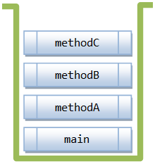
The Call Stack
What you see in the stack trace!
  Only one method is executing at a time, the rest are suspended
  Every time a method is called, an activation record (frame) is created and pushed onto the private call stack
  When the method finishes execution and returns control to the method that called it, the activation record is popped off the stack
  main() – at the bottom of the stack
Notes:
Example: main() calls methodA(), which calls methodB(), which then calls methodC()
Main(){
methodA();
}
methodA() {
methodB();
}
methodB() {
methodC()
}
Because this is a stack, the only accessible point is the TOP – which is frame associated to the current execution of the program. This is why local variables (including arguments passed into the method) scope are limited to the method! Once the method is popped off, everything in that frame is removed and no longer accessible!
Each frame also consist of a “return address”, or simply the point where it goes back to after it finishes (i.e. back to the caller). You can think of it as the line number where the method was called so it can come back and continue on the next line of code.

Slide 7
Parsers
Maintains a stack containing symbols encountered during parsing (reading and validating the source code)
  while( i > 0 ) {
  array[i] = i;
  i++;
  }
Notes:
Stack overflow?!

Slide 8
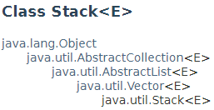
StackADT Implementations
Array-based
  This is what your assignment will be!
LinkedList-based
Java stack:
Notes:
https://docs.oracle.com/javase/8/docs/api/java/util/Stack.html

Slide 9
Problems with the java.util.Stack
Subclass of Vector (“is a” relationship)
  Therefore not a real stack!
    But rather a structure with stack-like operation
    The following is permitted:
        stack.setElementAt(“Sheraton”, 5);
        stack.remove(2);
    remove methods are inherited (from Vector) and can be used. But they should NEVER be used as this would violate LIFO guarantee
    The stack-vector relationship should be of the “has-a” variety instead of the “is-a”
Notes:
Unfortunately, this likely will never change.

Slide 10

Queues
Definition: a linear first-in-first-out (FIFO) sequence of elements where elements can only be added at one end (i.e. the tail) and removed at the other end (i.e. the head)
  The length of a queue is the number of elements it contains
    An empty queue has length zero
Notes:
Another restricted access list – only the first and last elements in a queue can be accessed.
“Queue” is just the first letter where the rest of the letters are waiting for their turn! :D

Slide 11
QueueADT Requirements
It must be possible to create an empty queue
It must be possible to add (“enqueue”) an element to the end of the queue
It must be possible to remove (“dequeue”) the first element from a queue
It should be possible to access (“peek”) the first element in a queue without removing it

Slide 12
Basic Queue Operations
new() – empty queue
enqueue(10)
enqueue(5)
enqueue(15)
dequeue()
peek()
dequeue()

Slide 13
Queues Applications
Any applications that requires preserving the order of insertion
  Elements are processed in the same order for integrity and fairness
  Examples:
    Print servers: maintains a queue of print jobs
    Disk drivers: maintains a queue of disk input/output requests
    Web servers: maintains a queue of HTTP requests
    Keyboard buffers: maintains a queue of key presses
    Network buffers: maintains a queue of network packets
    Simulations: maintains a queue of objects and events
Notes:
Computers often used to simulate behavior
Customers at a bank
Requests serviced by a cluster of Web servers
Traffic on roadways
All of these simulations consist of events
An event occurs at a given time, determined by the model used in the simulation
Events could include
Car N enters Highway 1 at Barlow Trail
Car N switches lanes at mile marker X
Car N leaves freeway at 14th Street NW
Simulation must keep track of thousands of events
Events ordered by the time they occur
Must process events in time order

Slide 14
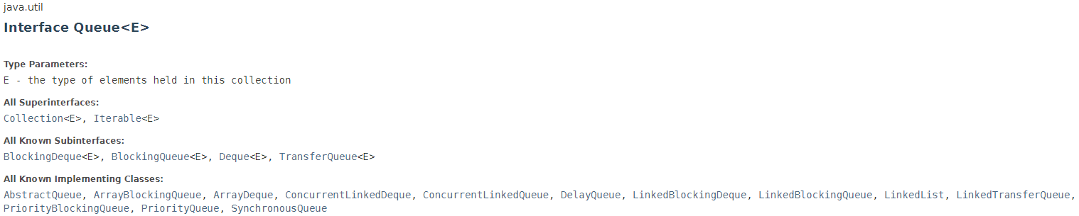
QueueADT Implementations
Array-based
LinkedList-based
  This is what your assignment will be!
Java queue:
Notes:
https://docs.oracle.com/javase/8/docs/api/java/util/Queue.html

